Slide 1
Synthesizing Notes on four A4 Papers

Slide 2
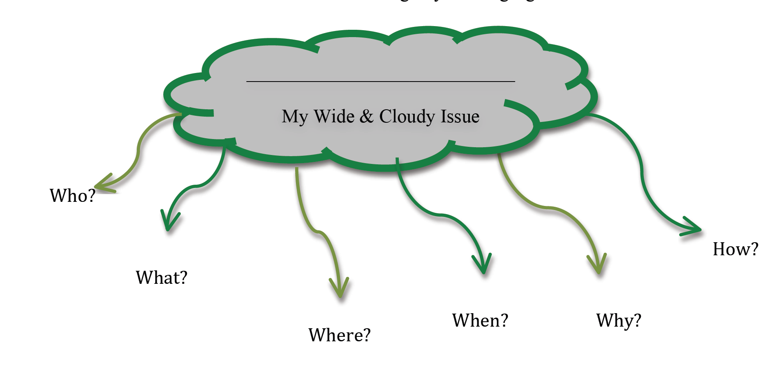
Research Questions
1.
2.
3.
4.
5.
Topic sentence and details of the causes.
Topic sentence and details of cases.
Topic sentence and possible solutions.
Topic Sentence and the basic definition of the issue
Topic sentence and details of the effects.
References
Last name, First name, date, title, publication
Notes from an Article #1
Notes from an Article #2
Notes from an Article #3
Notes from an Article #4
Notes from an Article #5
Notes from an Article #6

Slide 3
Research Questions
1.
2.
3.
4.
5.
Topic sentence and details of the causes.
Topic sentence and details of cases.
Topic sentence and possible solutions.
Topic Sentence and the basic definition of the issue
Topic sentence and details of the effects.
References
Last name, First name, date, title, publication
Notes from an Article #1
Notes from an Article #2
Notes from an Article #3
Notes from an Article #4
Notes from an Article #5
Notes from an Article #6

