Slide 1
Synthesizing Notes: The Structure Map
~on Three A4 pages with One A4 page of
References for APA or
Works Cited for MLA

Slide 2
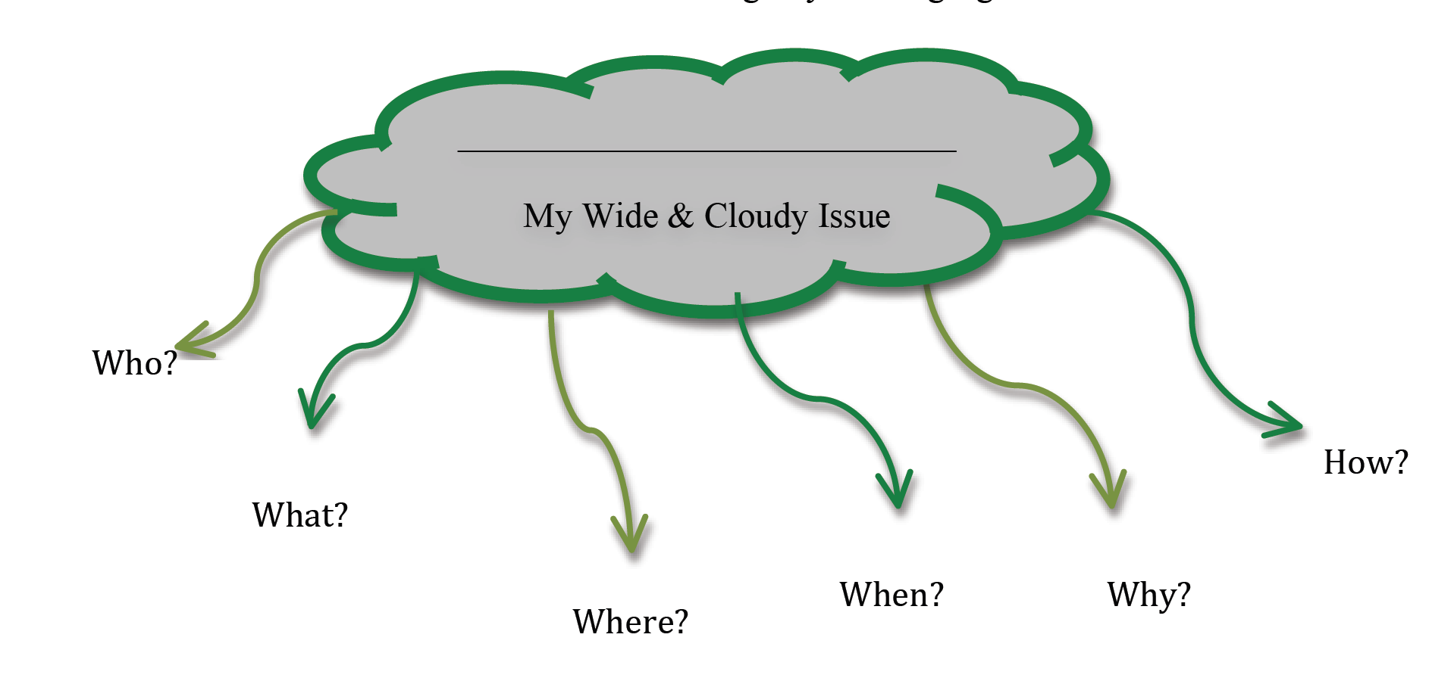
Research Questions
1.
2.
3.
4.
5.
Topic sentence and details.
Topic sentence and details.
Topic sentence and possible solutions.
Topic Sentence and definition of the issue
Topic sentence and details.
References
Last name, First name, date, title, publication
Notes from an Article
Notes from an Article
Notes from an Article
Notes from an Article
Notes from an Article
Notes from an Article

Slide 3
Heading 2
Heading 4
Heading 1
Research Questions
1.
2.
3.
4.
5.
Topic sentence and details.
Topic sentence and details.
Heading 2
Heading 1
Topic sentence and possible solutions.
Topic Sentence and definition of the issue
Heading 3
Topic sentence and details.
References (APA)
or
Works Cited (MLA)
Notes from an Article #1
Notes from an Article #2
Notes from an Article #3
Notes from an Article #4
Notes from an Article #5
Notes from an Article #6

