Slide 1
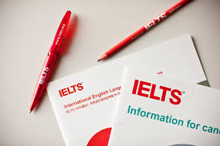
IELTS & How to Study English

Slide 2
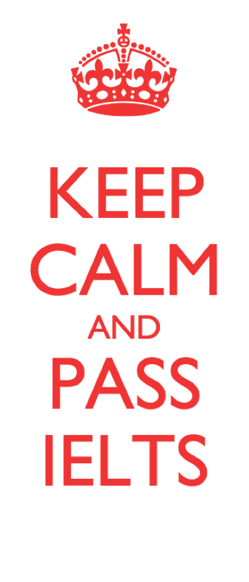
What you will learn more about today:
Entrance Requirements for your exchange program
TOEFL or IELTS?
IELTS Structure
IELTS Tips
Ways to get better at English

Slide 3

English Language Test Requirements
Search carefully on the university websites and consult your advisor(s)
IELTS or TOEFL?
Are both tests okay?
What scores do you need?
When do you need these scores?
← Important Questions to ask yourself, research carefully, and take notes on the results so you won’t forget them!
Image: North-West University,
South Africa

Slide 4
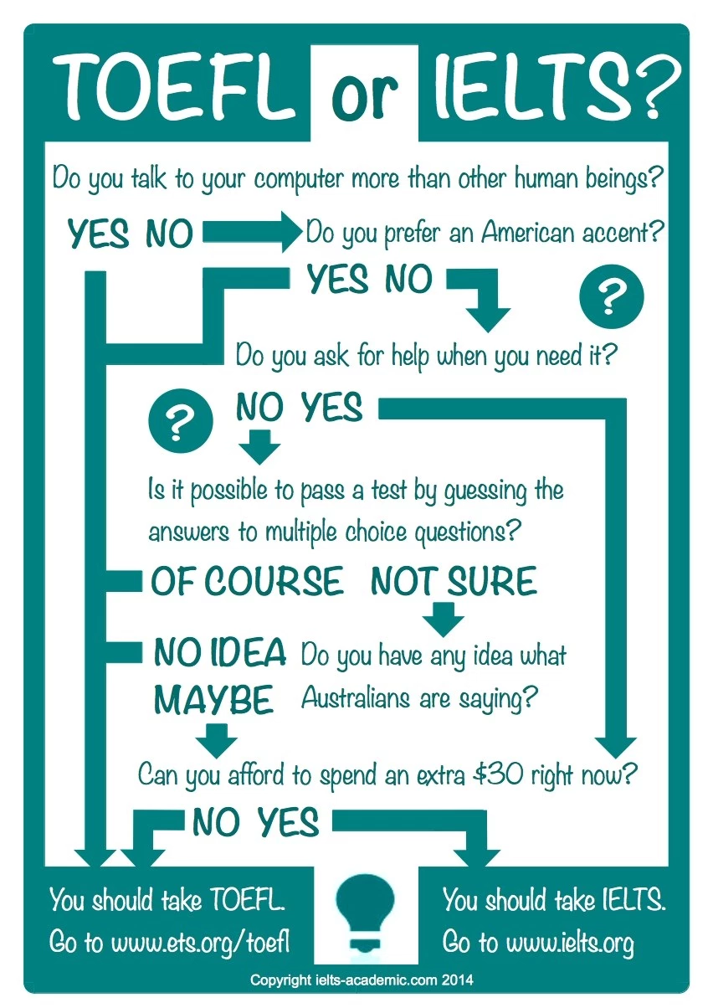
IELTS Academic (2014)
made a fun way of
thinking about both tests.

Slide 5
Which test is better for you?
TOEFL
IELTS
If you like step by step linear thinking.
If you like multiple choice questions (a, b, c, d).
If you feel more comfortable taking a test by computer than on paper.
If you can type in English very fast on a keyboard!
If you do not mind noises and detractions while speaking into a microphone on the computer.
No passport needed!
If you are good at spelling, grammar, and pay attention to language details.
If you like skipping questions to complete the easy ones first and save time for the difficult ones later.
If you are better at speaking and listening, especially if you have taken conversation classes.
If you can write English with a pencil faster than you can type in English.
If you like speaking with a person, who can help you calm down if you are nervous.
You need a passport!

Slide 6
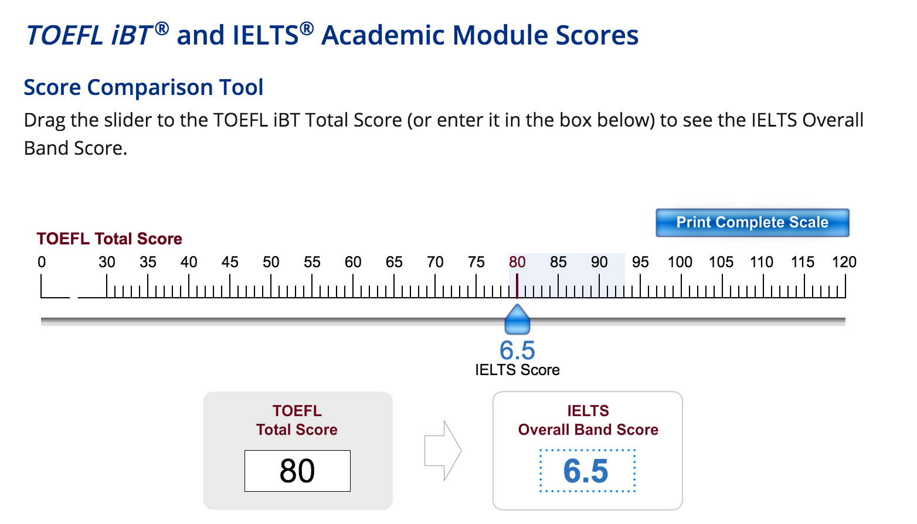
ETS (2016)

Slide 7
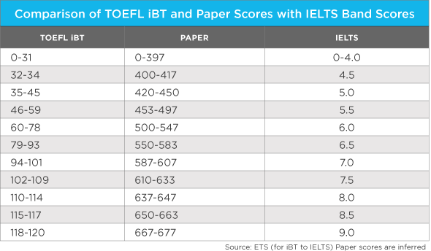
ETS (2016)

Slide 8

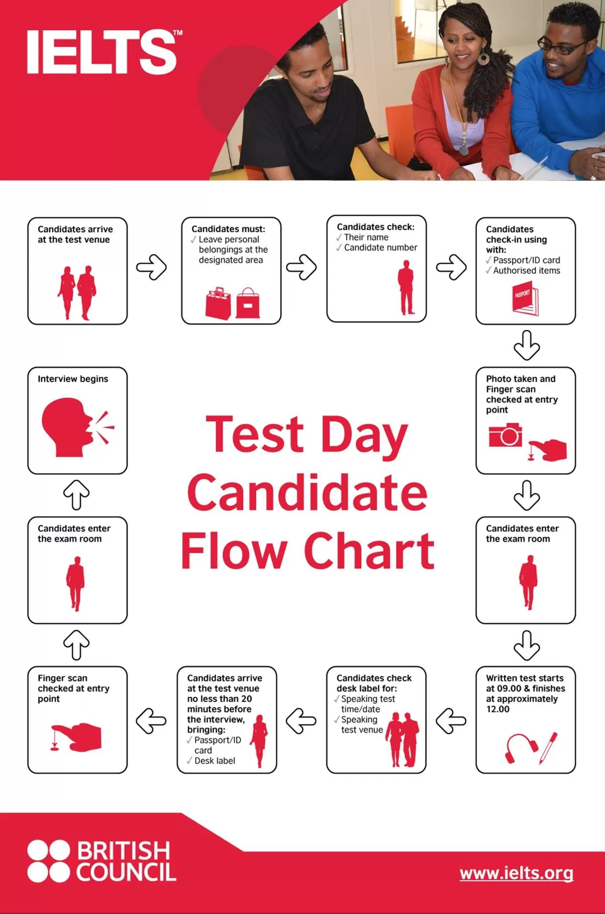

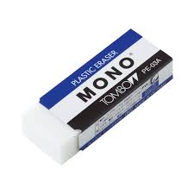

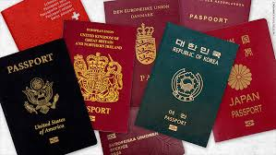
No cardboard
covers on
your eraser!
No labels on
your water
bottle!
Don’t forget your
passport!
CNN.com (2016)
No tissues!

Slide 9
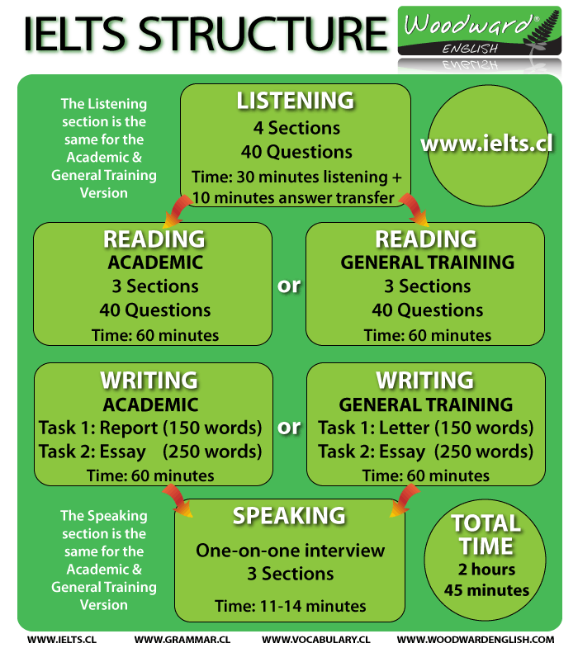

Slide 10
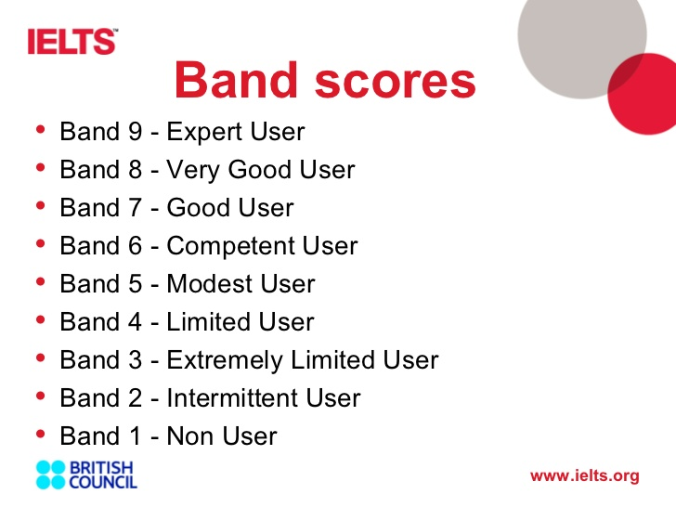

Slide 11

IELTS Listening Tips
Listen to the introduction to imagine what the situation is and what are the speakers doing.
Read ahead at the beginning of each section to understand the questions.
Write clearly and don’t miss a question.
Think of words with similar meanings.
Take good care of spelling, capitalization, and grammar.
Top Tips for IELTS (2009)
Clipart: discoveryschool.com

Slide 12

IELTS Reading Tips
Follow the instructions carefully, especially about the number of words you can use.
Do a quick read first to make sure you know what the topic is about, even if you don’t know all of the words.
You can write on the question paper, but you need to transfer your answers to the answer sheet, so it is good to remember this.
Go fast! If you take too much time on difficult questions you cannot finish this reading section.
There is a glossary of difficult words at the end of the text, so look for those.
Top Tips for IELTS (2009)
Clipart: discoveryschool.com

Slide 13

IELTS Writing Tips
Make sure you answer the questions.
Use words that link each sentence together.
Use a lot of different vocabulary and try not to use the same words again and again.
In task one, just answer the question about the graph/chart/pie, and do not give your opinion, just the facts . The task needs to be 150 words or more.
In task two it is 250 words or more, and please do write your opinion clearly with support and examples.
Take time to edit your tasks for spelling, grammar, and mistakes in the meaning.
Top Tips for IELTS (2009)
Clipart: discoveryschool.com

Slide 14

IELTS Speaking Tips
Spend a lot of time thinking in English before you speak.
Try to relax as best as you can. The examiner is there to try to help you feel comfortable at the beginning of the test.
Keep on speaking, don’t speak too fast.
Try to get a rhythm and speak with intonation.
Use fillers, like, ‘Let me see,’ or ‘Well…’ when you need to think.
Don’t worry about your grammar or if the interviewer stops you because there is limited time.
Top Tips for IELTS (2009)
Clipart: discoveryschool.com

Slide 15
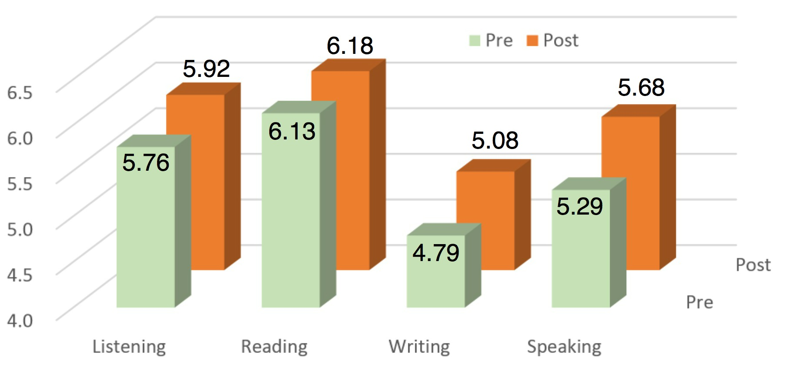
Vye’s Previous IELTS Study
20 students, 11 females; 9 males;
16 Japanese and 4 foreign nationals;
5 graduate students and 15 undergraduates;
met for 90 minutes once a week for 23 weeks between the IELTS pre- and post-tests;
they designed language plans in small study-groups;
they were active English users with IELTS scores ranging from 4.5 to 7.5; and
IELTS scores improved doing study for pleasure and studying over 6 hours a week!

Slide 16
References
Thank You for
Listening!
☺
Cambridge. (2009). Top tips for IELTS academic. Cambridge
University Press.
Clark N. (2016). Comparison of TOEFL iBT and paper scores with IELTS band test scores. World Education
News Reviews.
http://wenr.wes.org/2014/10/testing-english-as-a-foreign-language-for-university-admissions/
ETS. (2016). Score comparison tool. English testing service.
https://www.ets.org/toefl/institutions/scores/compare/
IDP. (2016). Who accepts IELTS? IDP Education. http://idpielts.me/
IELTS Academic. (2014). TOEFL or IELTS? Which test is for you. IELTS Academic.
http://ielts-academic.com/2014/08/02/toefl-or-ielts-which-test-is-for-you/
IELTS. (2016). What is IELTS? IELTS.org. https://ielts.org/
Woodward English School. (2015). What is IELTS? Woodward English School.
http://www.ielts.cl/what-is-ielts.htm

